Slide 1
K L (DEEMED TO BE) UNIVERSITY / COMPUTER SCIENCE & ENGINEERING
Thread Pool Based
Task Processing System
A bounded, adaptive and observable
concurrent task execution system
PROJECT TEAM
FACULTY GUIDE
R Hema Manikanta Kumar Reddy · 2520090228
T Venkata Siddartha · 2520090187
D Sanjay · 2520090133
Raghupathi M
OSSP · Batch 16 · Section 12
Hyderabad · Academic Year 2026–2027
THREAD POOL BASED TASK PROCESSING SYSTEM / OSSP PROJECT
01

Slide 2
01 / PROJECT OVERVIEW
A practical application of concurrency
A system that executes many small tasks on a fixed set of reusable threads.
THE NEED
THE APPROACH
THE OUTCOME
Creating a new thread for every task is costly and unsafe under heavy load.
A bounded pool of reusable worker threads pulls tasks from a shared queue.
Higher throughput, stable memory and live metrics for every task.
Core principle: reuse threads, bound the queue, and keep every task observable.
Useful for servers, batch jobs, pipelines and students learning concurrency.
THREAD POOL BASED TASK PROCESSING SYSTEM / OSSP PROJECT
02

Slide 3
02 / PROBLEM STATEMENT
Thread-per-task does not scale
Creating a new thread for every task wastes resources and collapses under heavy load.
01 HIGH OVERHEAD
02 RESOURCE EXHAUSTION
03 NO CONTROL
Thread creation and teardown per request can cost more than the work itself.
Unbounded threads drain memory and cause heavy context switching.
No back-pressure, and little visibility into task state or failures.
Problem statement: executing every task on a new thread cannot handle bursts of load safely.
THREAD POOL BASED TASK PROCESSING SYSTEM / OSSP PROJECT
03

Slide 4
03 / PROBLEM DEFINITION
Define what the system must do
Design a thread pool that runs tasks asynchronously on a fixed, reusable set of worker threads.
SCOPE
OBJECTIVES
CONSTRAINTS
Task submission API
Bounded queue and workers
Results and metrics
Higher throughput
Stable memory under load
Clean shutdown
Thread-safe by design
Configurable pool size
No lost or duplicate tasks
Problem definition: build a bounded, observable pool that stays safe while tasks run concurrently.
THREAD POOL BASED TASK PROCESSING SYSTEM / OSSP PROJECT
04

Slide 5
04 / NOVELTY & INNOVATION
Innovation through thoughtful engineering
The project adds practical features on top of the basic thread pool idea.
ADAPTIVE POOL SIZING
PRIORITY QUEUE WITH AGING
Workers scale between a minimum and maximum based on queue depth, then shrink when idle.
High-priority tasks run first; waiting time raises priority to prevent starvation.
PLUGGABLE REJECTION POLICIES
BUILT-IN OBSERVABILITY
Block, caller-runs, drop-oldest or reject, chosen per workload.
Live metrics for queue depth, active threads, throughput and task latency.
Novelty is based on the documented design, not a claim of being the first such system.
THREAD POOL BASED TASK PROCESSING SYSTEM / OSSP PROJECT
05

Slide 6
05 / OS CONCEPTS
Operating-system ideas in action
The project makes concurrency and synchronization visible in a real system.
THREADS
MUTUAL EXCLUSION
CONDITION VARIABLE
Worker threads share process resources and run tasks in parallel.
Locks protect the task queue and shared counters.
Idle workers wait efficiently until tasks arrive or shutdown begins.
ATOMIC STATE
PRODUCER-CONSUMER
THREAD LIFECYCLE
Atomic flags and counters track running state and metrics.
Clients produce tasks; workers consume them from a bounded queue.
Owned threads are started, reused and joined during clean shutdown.
THREAD POOL BASED TASK PROCESSING SYSTEM / OSSP PROJECT
06

Slide 7
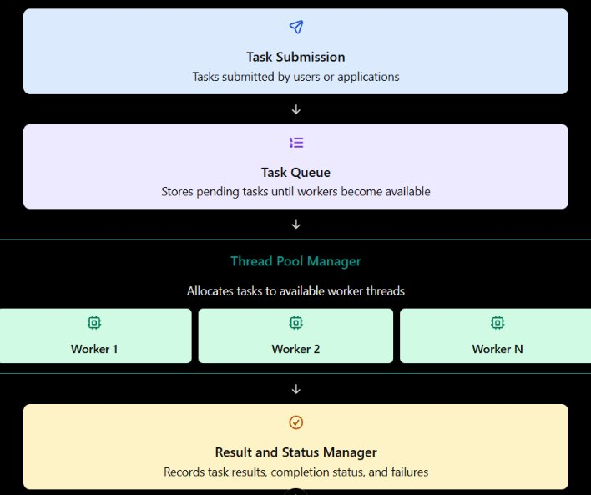
06 / ARCHITECTURE DESIGN
A modular pipeline with clear responsibilities
Submission, queueing, pool management and result handling are separated.
TASK SUBMISSION
Tasks are submitted by users or applications.
TASK QUEUE
Stores pending tasks until workers become available.
THREAD POOL MANAGER
Allocates tasks to available worker threads (Worker 1 to N).
RESULT AND STATUS MANAGER
Records task results, completion status and failures.
Figure: system architecture
THREAD POOL BASED TASK PROCESSING SYSTEM / OSSP PROJECT
07

Slide 8
07 / WORKFLOW
From task submission to result
Producers submit work and the pool executes it independently.
01
02
03
04
05
Submit task
Enqueue (bounded)
Apply rejection policy if full
Worker takes task
Execute task
06
07
08
09
10
Capture result or error
Update metrics
Scale pool if needed
Read result via Future
Graceful shutdown
On shutdown the pool finishes or discards queued tasks and joins all owned threads.
THREAD POOL BASED TASK PROCESSING SYSTEM / OSSP PROJECT
08

Slide 9
08 / IMPLEMENTATION
Implementation choices that matter
Focused engineering details behind the system.
TASK QUEUE
WORKERS
REJECTION POLICIES
Bounded, thread-safe blocking queue gives back-pressure.
Each worker loops: take a task, run it, report the result.
Overflow is handled by block, caller-runs, drop-oldest or reject.
ADAPTIVE SCALING
SHUTDOWN
BUILD & TEST
The manager grows or shrinks the pool using queue depth.
Graceful and immediate modes; all owned threads are joined.
Maven build with JUnit 5 tests and JMH benchmarks.
THREAD POOL BASED TASK PROCESSING SYSTEM / OSSP PROJECT
09

Slide 10
09 / TECHNOLOGIES USED
Tools and technologies
Standard, well-supported tools for concurrency, testing and monitoring.
LANGUAGE
CONCURRENCY
TESTING
Java 17
java.util.concurrent, locks and atomics
JUnit 5 and Mockito
BENCHMARKING
MONITORING
BUILD / VERSION CONTROL
JMH micro-benchmarks
JMX and VisualVM
Maven and Git
THREAD POOL BASED TASK PROCESSING SYSTEM / OSSP PROJECT
10

Slide 11
10 / TESTING & VALIDATION
A documented test plan
Test targets for each part of the system; outcomes are recorded by running the suite.
UNIT TESTS
CONCURRENCY TESTS
Queue ordering, worker lifecycle, rejection policies, shutdown.
Many producers: races, deadlocks and lost tasks.
LOAD AND STRESS TESTS
FAULT TESTS
Burst traffic: back-pressure and memory behaviour.
Throwing tasks and interrupted threads must not kill the pool.
Validation step: run mvn test and record the actual output.
THREAD POOL BASED TASK PROCESSING SYSTEM / OSSP PROJECT
11

Slide 12
11 / RESULTS
Throughput by configuration
Sample data for layout: replace with your measured benchmark results.
3.2x
higher throughput (sample)
45%
lower p95 latency (sample)
0
lost tasks in stress runs (sample)
THREAD POOL BASED TASK PROCESSING SYSTEM / OSSP PROJECT
12

Slide 13
12 / TEAMWORK & IMPACT
Who benefits, and how the team collaborates
Replace contribution placeholders with the work each member actually completed.
R HEMA MANIKANTA KUMAR REDDY · 2520090228
T VENKATA SIDDARTHA · 2520090187
D SANJAY · 2520090133
Contribution: [add actual module / responsibility]
Contribution: [add actual module / responsibility]
Contribution: [add actual module / responsibility]
IMPACT
Performance: thread reuse removes creation cost and increases throughput.
Reliability: bounded queues and isolated failures keep the system stable.
Reusability: a clean API suitable for servers, batch jobs and pipelines.
THREAD POOL BASED TASK PROCESSING SYSTEM / OSSP PROJECT
13

Slide 14
13 / CONCLUSION & REPOSITORY
A practical demonstration of operating-system design
Concurrency is valuable when paired with clear architecture and safe coordination.
TAKEAWAY
GITHUB REPOSITORY
A bounded, adaptive and observable thread pool replaces costly thread-per-task execution and gives a reusable base for concurrent applications.
Add your real repository URL here:
[PASTE GITHUB REPOSITORY LINK]
REFERENCES
Java SE docs: docs.oracle.com/en/java/javase/17 · JUnit 5: junit.org/junit5 · JMH: github.com/openjdk/jmh · Maven: maven.apache.org
THANK YOU · QUESTIONS
THREAD POOL BASED TASK PROCESSING SYSTEM / OSSP PROJECT
14

